Slide 1
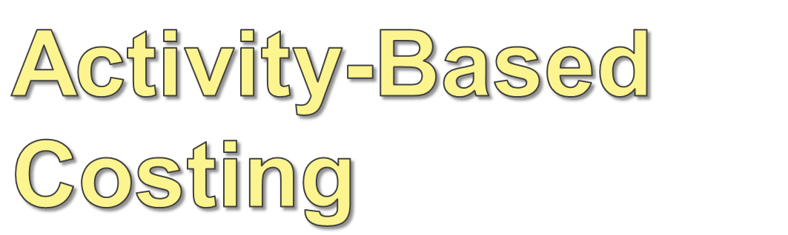

Slide 2
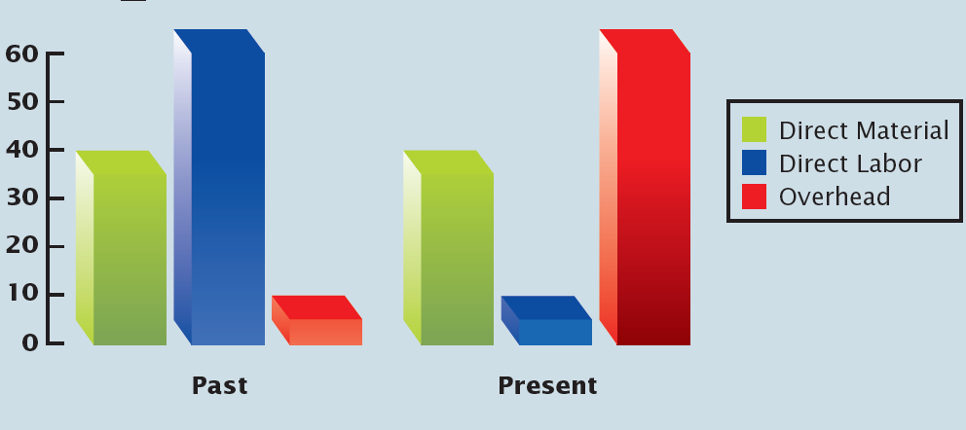
Overheads as % of total Manufacturing costs

Slide 3
Activity Based Costing
Volume-based allocation methods work best if the manufacturing environment includes mostly unit-level costs (costs that vary with every unit produced or the volume of production).
Activity-based
costing provides an alternative to traditional methods. By allocating overhead costs on the basis of activities that lead to the overhead costs, this method is effective in automated, diverse product environments.
Notes:
.

Slide 4
Cost Levels
As an alternative to traditional costing methods, ABC allocates overhead costs on the basis of activities that drive costs. To do this, it is important to understand the level at which costs are incurred.
Unit-LEVEL COSTS
Product-LEVEL COSTS
Batch-LEVEL COSTS
Facility-LEVEL COSTS

Slide 5
Unit-Level Costs
Unit-LEVEL COSTS are incurred each time a unit is produced.
Examples:
Supplies for factory
Depreciation of factory machinery
Product-LEVEL COSTS
Batch-LEVEL COSTS
Facility-LEVEL COSTS

Slide 6
Product-Level Costs
Unit-LEVEL COSTS are incurred each time a unit is produced.
Examples:
Supplies for factory
Depreciation of factory machinery
Product-LEVEL COSTS are incurred for each type of product produced.
Examples:
Salaries of engineers
Product development costs
Batch-LEVEL COSTS
Facility-LEVEL COSTS

Slide 7
Batch-Level Costs
Unit-LEVEL COSTS are incurred each time a unit is produced.
Examples:
Supplies for factory
Depreciation of factory machinery
Batch-LEVEL COSTS
are incurred for batches of goods produced.
Examples:
Salaries for purchasing
Depreciation for setup equipment
Product-LEVEL COSTS are incurred for each type of product produced.
Examples:
Salaries of engineers
Product development costs
Facility-LEVEL COSTS

Slide 8
Facility-Level Costs
Unit-LEVEL COSTS are incurred each time a unit is produced.
Examples:
Supplies for factory
Depreciation of factory machinery
Batch-LEVEL COSTS
are incurred for batches of goods produced.
Examples:
Salaries for purchasing
Depreciation for setup equipment
Product-LEVEL COSTS are incurred for each type of product produced.
Examples:
Salaries of engineers
Product development costs
Facility-LEVEL COSTS sustain general facility processes.
Examples:
Insurance and taxes
Salary of plant manager

Slide 9
Summary of Costs Levels
Unit-LEVEL COSTS are incurred each time a unit is produced.
Examples:
Supplies for factory
Depreciation of factory machinery
Batch-LEVEL COSTS
are incurred for batches of goods produced.
Examples:
Salaries for purchasing
Depreciation for setup equipment
Product-LEVEL COSTS are incurred for each type of product produced.
Examples:
Salaries of engineers
Product development costs
Facility-LEVEL COSTS sustain general facility processes.
Examples:
Insurance and taxes
Salary of plant manager

Slide 10
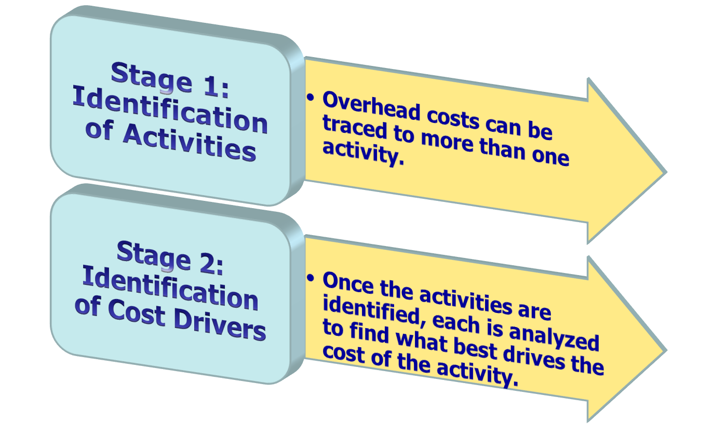
Assigning Overhead
Costs Under ABC

Slide 11
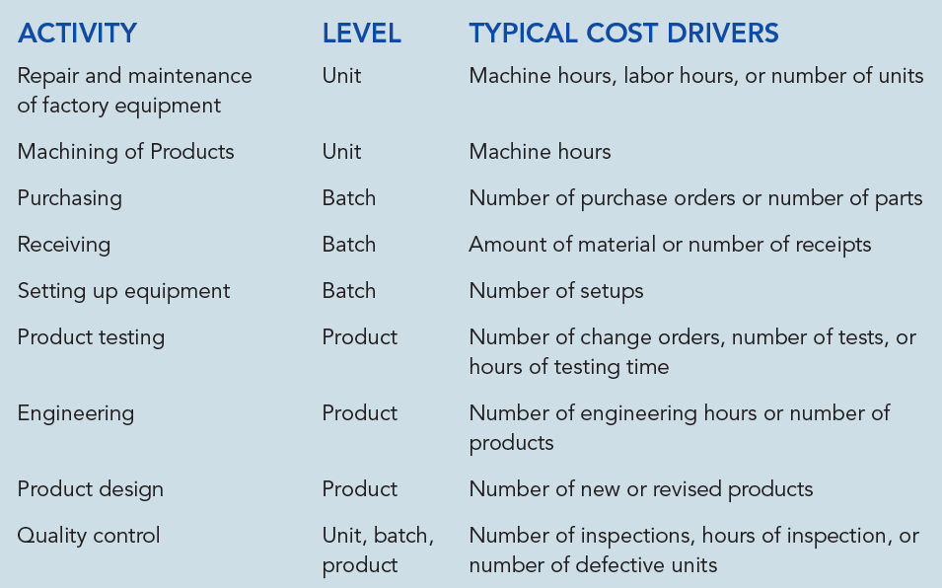
Activities and Cost Drivers

Slide 12
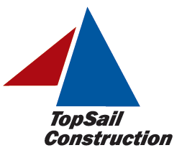
Overhead Allocation –
Traditional and ABC
Let’s look at an example of overhead costs for TopSail Construction Company, a modular home builder.

Slide 13
Estimated Overhead Costs
Overhead Item | Estimated Cost
Indirect Materials | Rs.90,000,000
Indirect Labor: Construction supervisors Part-time workers | 25,000,000 10,000,000
Other Overhead: Allocated service dept. cost Tools Trucks and other equipment | 39,000,000 7,500,000 20,000,000
Total | 191,500,000

Slide 14
Traditional Allocation with
Two Product Models
TopSail builds two basic models—a 1200-square-foot unit and a 1600-square-foot unit.
If TopSail expects to produce 150 of each model and allocates on square-footage
Total floor space =
[(150 x 1,200) + (150 X 1,600)] = 420,000 sq. ft.
Overhead Allocation $19,15,00,000 ÷ 420,000 = $456 per square foot

Slide 15
Traditional Allocation with
Two Product Models
1,200 sq. ft.
1,600
sq. ft.
Overhead per unit =
1,200 x Rs.456 = Rs.547,200
Overhead per unit =
1,600 x Rs.456 = Rs.729,600

Slide 16
Traditional Allocation and a New Product
TopSail is considering the production of a new 500-square-foot cottage model for emergency organizations, like FEMA.
The price cannot exceed Rs.1,875,000, the cost cannot exceed Rs.1,500,000, 1,000 will be sold, and estimated overhead will increase to Rs.3,36,000,000.
Should the company use the traditional method of overhead allocation?

Slide 17
Traditional Allocation with
Three Product Models
With the new units added:
Total floor space =
[(150 x 1,200) + (150 X 1,600) + (1,000 x 500] = 920,000 sq. ft.
Overhead Allocation Rs.3,36,000,000 ÷ 920,000 = Rs.365 per square foot

Slide 18
Traditional Allocation with
Three Product Models
500 sq. ft.
1,200 sq. ft.
Overhead per unit =
500 x Rs.365 = Rs.182,500
1,600
sq. ft.
Overhead per unit =
1,200 x 365 = Rs.438,000
Overhead per unit =
1,600 x 365 = Rs.584,000

Slide 19
Costs Per Unit Using Volume-Based Overhead Allocation
Two - Three
Bedroom Bedroom
Unit Unit Cottage
-----------------------------------------------------------------
Number of units 150 150 1,000
Direct material Rs.1,500,000 Rs.2,000,000 825,000
Direct labor 900,000 1,200,000 525,000
Overhead 438,000 584,000 182,500
---------------- ---------------- --------------
Total cost per unit 2,838,000 3,784,000 1,532,500
Using Volume-Based Overhead Allocation, the Cottage exceeds the cost desired by Rs.32,500.
Since the cottage is simpler to build and uses less resources than the other houses, let’s see if ABC should be used in this case, since it provides more accurate allocations.

Slide 20
ABC Stage 1: Identification of Activities
Activity Estimated Cost
Inspections Rs.45,000,000
Purchasing 25,000,000
Supervision 70,000,000
Delivery and setup 196,000,000
---------------------
Total overhead 336,000,000
---------------------

Slide 21
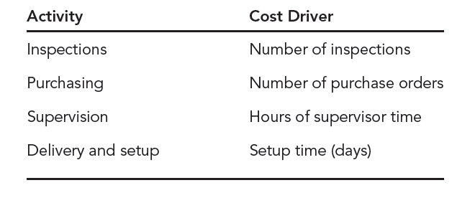
ABC Stage 2: Identification of Cost Drivers
Notes:
Once the activities have been identified and overhead costs traced to each activity, cost drivers must be identified for each activity. Each of these cost drivers is directly associated with the related activity. Accordingly, the cost of inspections is driven by the number of inspections, the cost of purchasing is driven by the number of purchase orders processed, and so on.

Slide 22
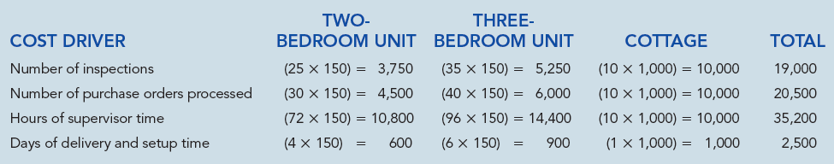
Estimated Cost Driver Activity and Predetermined Activity Rates
TOTAL ESTIMATED COST DRIVER AND PREDETRMINED
ACTIVITY COST ESTIMATED AMMOUNT OVERHEAD RATE
Inspections Rs.45,000,000 Number of Inspections (19,000) Rs.2,368.50 per inspection
Purchasing 25,000,000 Number of purchase orders (20,500) Rs.1,219.50 per purchase order
Supervision 70,000,000 Hours of supervision time (35,200) Rs. 1,988.50 per supervision hour
Delivery and setup 196,000,000 Setup time (days) (2,500) Rs. 78,400 per day

Slide 23
ABC – Total Cost of Each Unit
TWO THREE
COST BEDROOM UNIT BEDROOM UNIT COTTAGE
Direct materials Rs.1,500,000 Rs.2,000,000 Rs.825,000
Direct labor 900,000 1,200,000 525,000
Inspections 59,200 82,900 23,700
Purchases 36,600 48,800 12,200
Supervision 143,200 190,900 19,900
Delivery and setup 313,600 470,400 78,400
----------------- ------------------- ------------------
Total cost per unit 2,952,600 3,993,000 1,484,200
----------------- -------------------- -------------------

Slide 24
Comparing Cost and Price for Both Costing Methods (SP = 125% of Total Manufacturing Cost)
Cost Comparison | 1,200 sq. ft. | 1,600 sq. ft. | 500 sq. ft.
Traditional costing | Rs.2,838,000 | Rs.3,784,000 | Rs.1,532,500
Activity-based costing | 2,952,600 | 3,993,000 | 1,484,200
Difference in cost | Rs.114,600 higher w/ABC | Rs.209,000 higher w/ABC | Rs.48,300 lower w/ABC
Price Comparison
Sales price based on traditional costing | Rs.3,547,500 | Rs.4,730,000 | Rs.1,915,625
Sales price based on ABC | Rs.3,690,750 | Rs.4,991,250 | Rs.1,855,250
Difference in price | Rs.143,250 higher w/ABC | Rs.261,250 higher w/ABC | Rs.60,375 lower w/ABC
MODELS

Slide 25
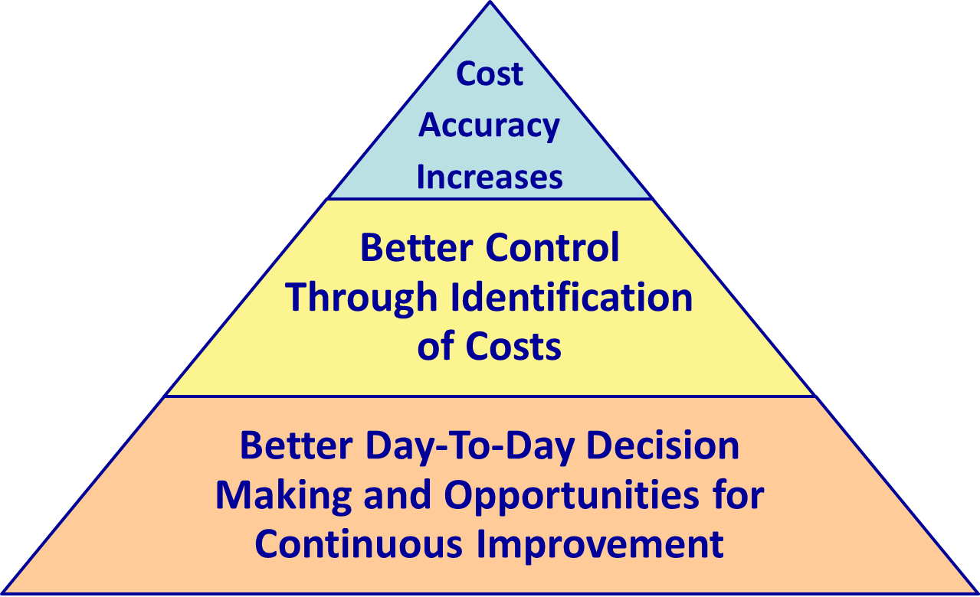
Benefits of ABC

Slide 26
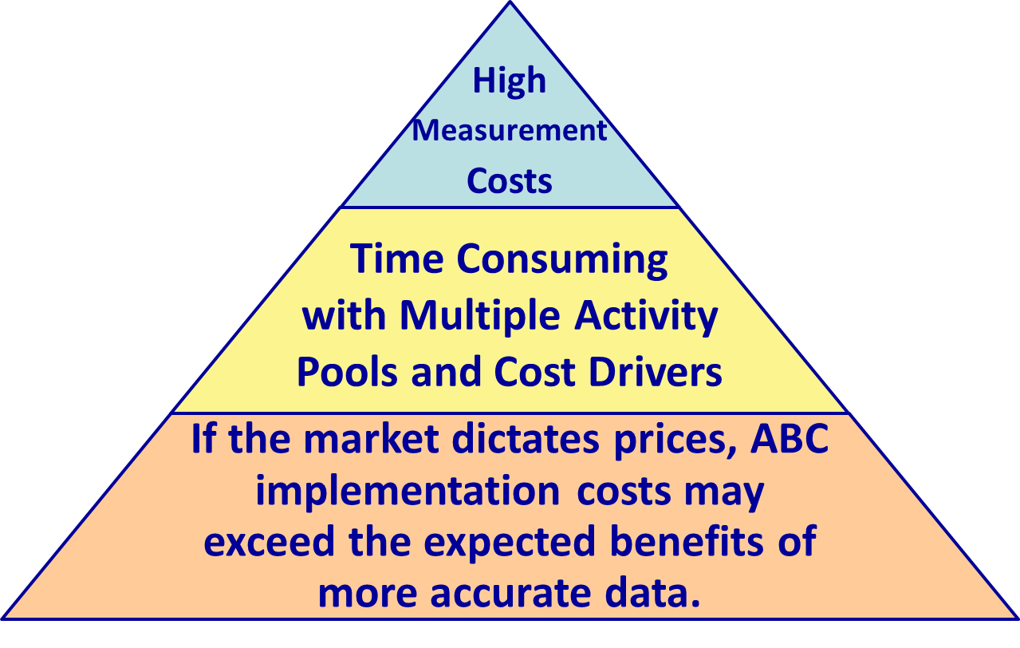
Limitations of ABC

Slide 27
Who Benefits from ABC?
Cost Distortions
Non-Unit-Level Costs
????
Companies Benefiting From ABC
Diverse, Complex Products
Higher % of Overhead

